Slide 1
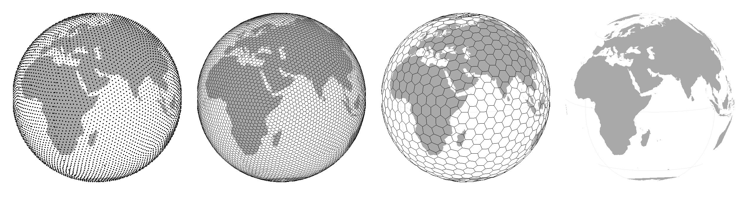
Biodiversity II – spatial scale (a.k.a. area, grain, or resolution)
Petr Keil
Notes:
Hi, my name is Petr Keil and this is my project Biodiversity dynamics across a continuum of space, time, and their scales.

Slide 2
Species-area relationship (SAR)
One of the few laws of ecology
Notes:
I am qualified to deliver all this

Slide 3
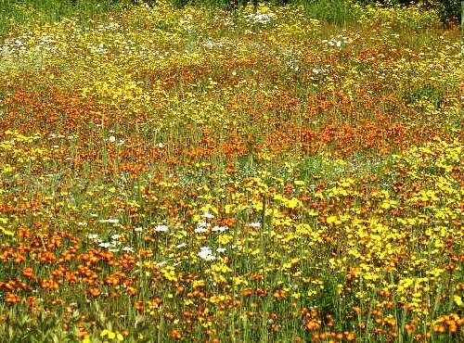
Species-area relationship: the basics
Notes:
In this panel we can probably all agree that biodiversity is one of the most valuable natural resources.
But things like climate change or habitat loss are a threat to biodiversity, to the extent that we hear about biodiversity crisis, or sixth mass extinction
For example, about 1% of vertebrate species have gone extinct because of humans

Slide 4
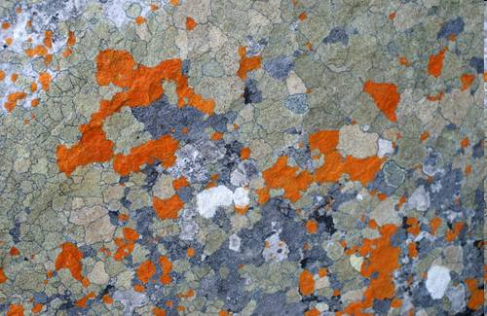
Species-area relationship: the basics
Notes:
In this panel we can probably all agree that biodiversity is one of the most valuable natural resources.
But things like climate change or habitat loss are a threat to biodiversity, to the extent that we hear about biodiversity crisis, or sixth mass extinction
For example, about 1% of vertebrate species have gone extinct because of humans

Slide 5
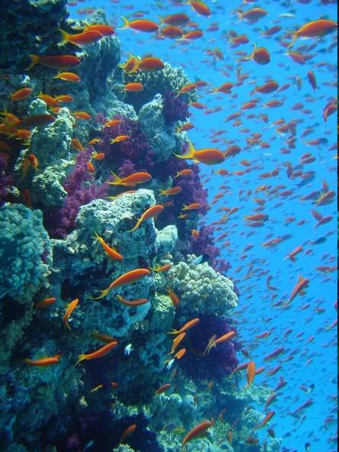
Species-area relationship: the basics
Note: This is more about volume
Notes:
In this panel we can probably all agree that biodiversity is one of the most valuable natural resources.
But things like climate change or habitat loss are a threat to biodiversity, to the extent that we hear about biodiversity crisis, or sixth mass extinction
For example, about 1% of vertebrate species have gone extinct because of humans

Slide 6
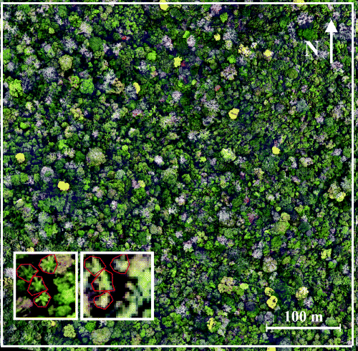
Species-area relationship: the basics
Notes:
In this panel we can probably all agree that biodiversity is one of the most valuable natural resources.
But things like climate change or habitat loss are a threat to biodiversity, to the extent that we hear about biodiversity crisis, or sixth mass extinction
For example, about 1% of vertebrate species have gone extinct because of humans

Slide 7
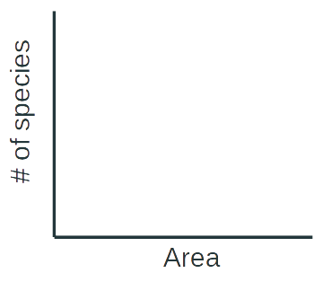

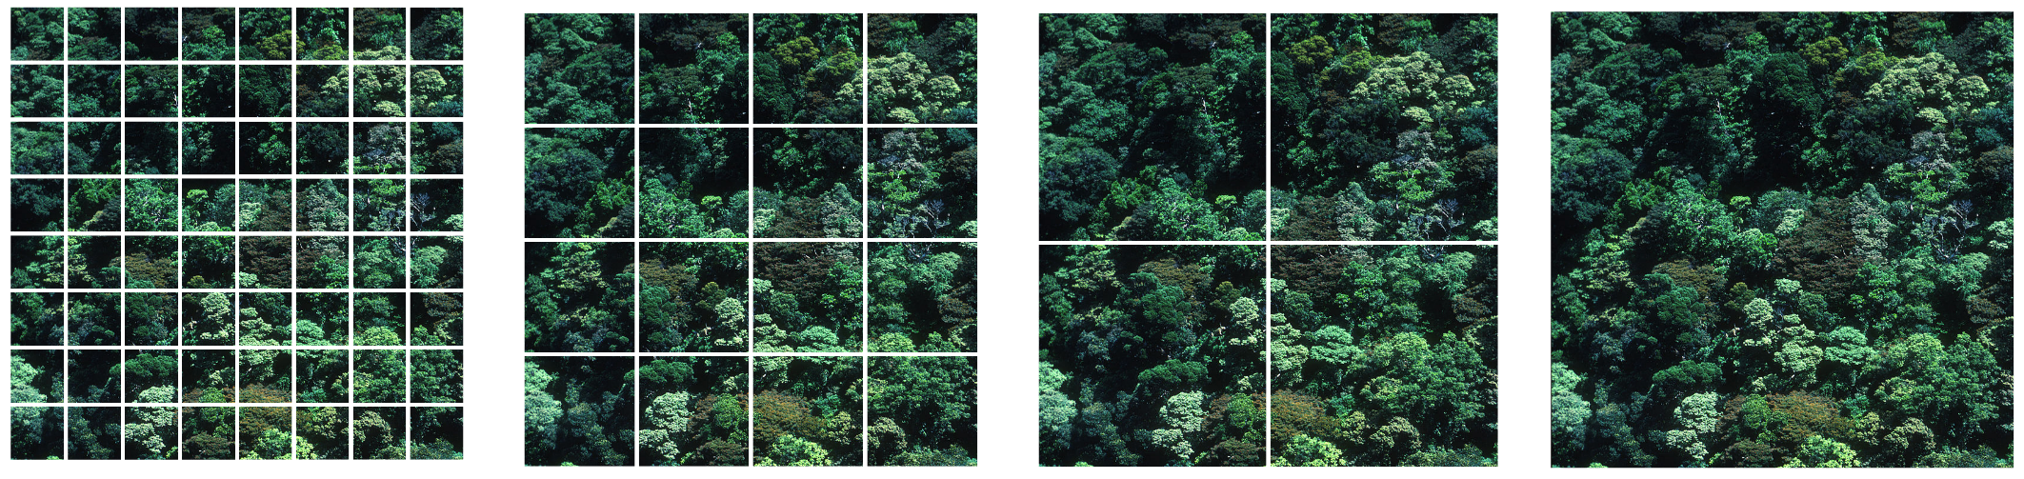


Species-area relationship: the basics
(S)
(S)
Power law (mocninná funkce)
$$S=cA^{z}$$
$$\log\left(S\right)=\log\left(c\right)+z\log{(A)}$$
log
(A)
log
(A)
Arrhenius (1921) Journal of Ecology
Notes:
In this panel we can probably all agree that biodiversity is one of the most valuable natural resources.
But things like climate change or habitat loss are a threat to biodiversity, to the extent that we hear about biodiversity crisis, or sixth mass extinction
For example, about 1% of vertebrate species have gone extinct because of humans

Slide 8
Species-Area Relationship: link between alpha, beta, and gamma diversity
γ
Slope of SAR is proportional to beta diversity. The steeper the SAR, the higher beta diversity.
(S)
α
β=γ/α
log
log
(A)
Notes:
In this panel we can probably all agree that biodiversity is one of the most valuable natural resources.
But things like climate change or habitat loss are a threat to biodiversity, to the extent that we hear about biodiversity crisis, or sixth mass extinction
For example, about 1% of vertebrate species have gone extinct because of humans

Slide 9
Species-Area Relationship: link between alpha, beta, and gamma diversity
γ
(S)
Slope of SAR is proportional to beta diversity. The steeper the SAR, the higher beta diversity.
α
β=γ/α
log
log
(A)
High beta diversity
Low beta diversity
The slope of SAR (beta diversity) reflects species spatial aggregation.
γ
γ
α
α
Notes:
In this panel we can probably all agree that biodiversity is one of the most valuable natural resources.
But things like climate change or habitat loss are a threat to biodiversity, to the extent that we hear about biodiversity crisis, or sixth mass extinction
For example, about 1% of vertebrate species have gone extinct because of humans

Slide 10


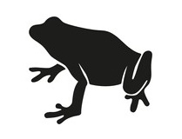
Local, regional, and continental SAR
Rescaled # of species
Rescaled Area
Log Area
Storch, Keil & Jetz (2012) Nature
Keil, Storch & Jetz(2015) Nature Communications
Notes:
In this panel we can probably all agree that biodiversity is one of the most valuable natural resources.
But things like climate change or habitat loss are a threat to biodiversity, to the extent that we hear about biodiversity crisis, or sixth mass extinction
For example, about 1% of vertebrate species have gone extinct because of humans

Slide 11
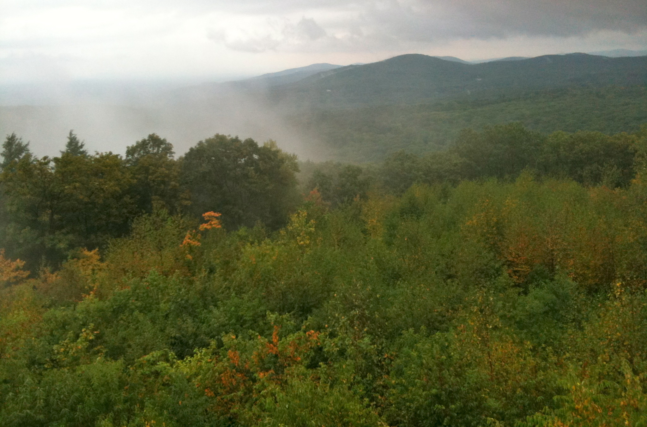
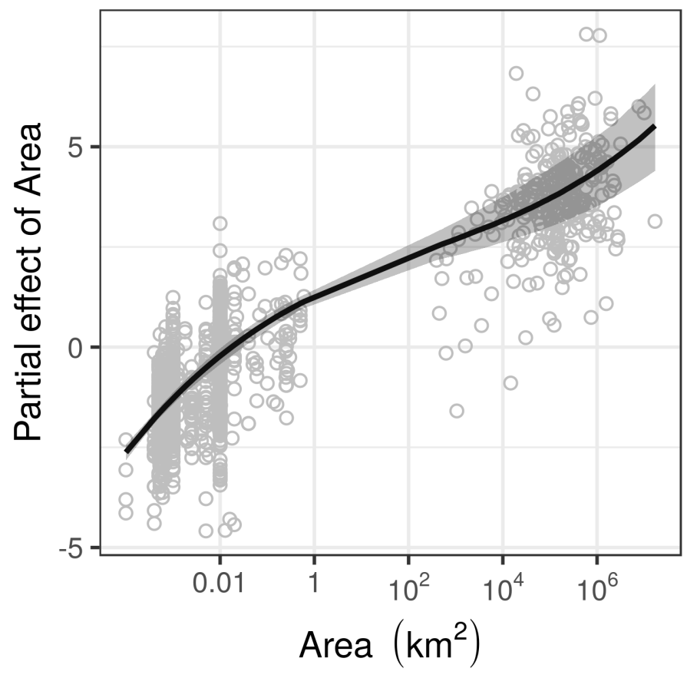
Local, regional, and continental SAR – the tri-phasic function
Theoretical expectation
Empirical relationship in global forests
Local
Continental
Storch (2016) Journal of Vegetation Science
Keil & Chase (2019) Nature Ecology and Evolution
Notes:
In this panel we can probably all agree that biodiversity is one of the most valuable natural resources.
But things like climate change or habitat loss are a threat to biodiversity, to the extent that we hear about biodiversity crisis, or sixth mass extinction
For example, about 1% of vertebrate species have gone extinct because of humans

Slide 12
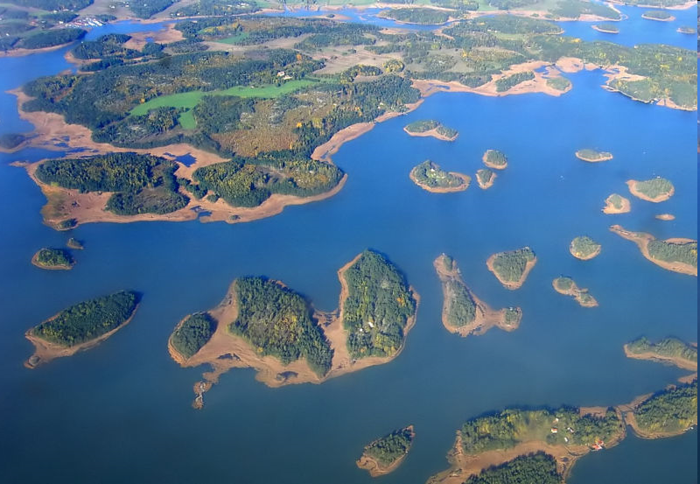
Island (non-nested) Species-Area relationship (ISAR)
Notes:
In this panel we can probably all agree that biodiversity is one of the most valuable natural resources.
But things like climate change or habitat loss are a threat to biodiversity, to the extent that we hear about biodiversity crisis, or sixth mass extinction
For example, about 1% of vertebrate species have gone extinct because of humans

Slide 13
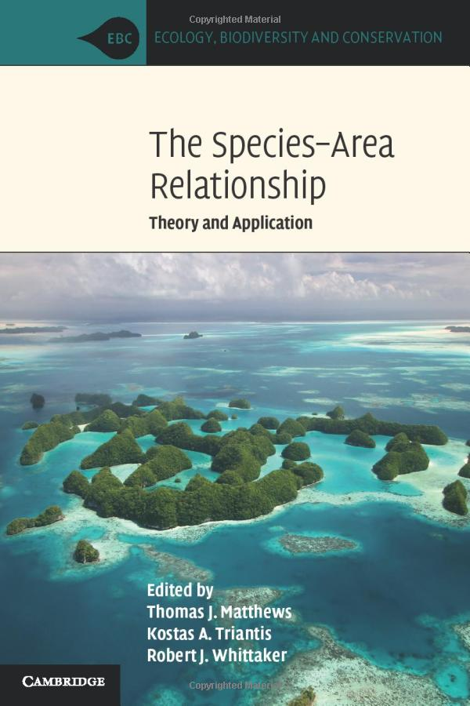
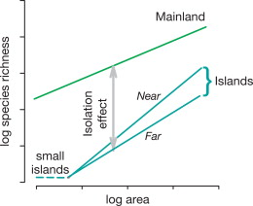
Island (non-nested) Species-Area relationship (ISAR)
Lomolino et al. (2006)
Notes:
In this panel we can probably all agree that biodiversity is one of the most valuable natural resources.
But things like climate change or habitat loss are a threat to biodiversity, to the extent that we hear about biodiversity crisis, or sixth mass extinction
For example, about 1% of vertebrate species have gone extinct because of humans

Slide 14
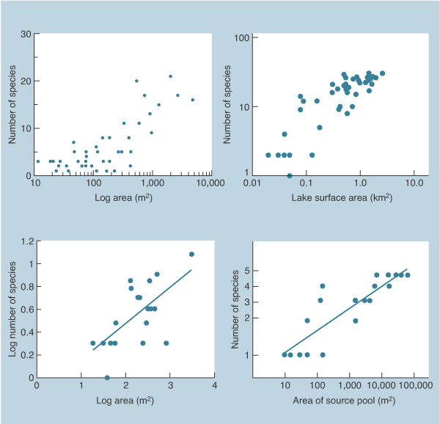
Island (non-nested) Species-Area relationship (ISAR)
plants on Bahamas
birds on Florida lakes
bats in Mexican caves
fish in Austr. ponds
Begon et al. (2010) Ecology: From individuals to ecosystems
Notes:
In this panel we can probably all agree that biodiversity is one of the most valuable natural resources.
But things like climate change or habitat loss are a threat to biodiversity, to the extent that we hear about biodiversity crisis, or sixth mass extinction
For example, about 1% of vertebrate species have gone extinct because of humans

Slide 15
You should know
Number of species monotonically increases with area, following what is called a “species-area relationship” (SAR)
This is one of the few real laws of ecology
Over a limited extent of areas it can be approximated by a power function
From local to continental areas it is tri-phasic (s-shaped)
The slope of the species-area relationship is proportional to the ratio of alpha and gamma diversity, which is driven by species aggregation
Notes:
In this panel we can probably all agree that biodiversity is one of the most valuable natural resources.
But things like climate change or habitat loss are a threat to biodiversity, to the extent that we hear about biodiversity crisis, or sixth mass extinction
For example, about 1% of vertebrate species have gone extinct because of humans

Slide 16
Scale dependence of biodiversity patterns
Notes:
I am qualified to deliver all this

Slide 17
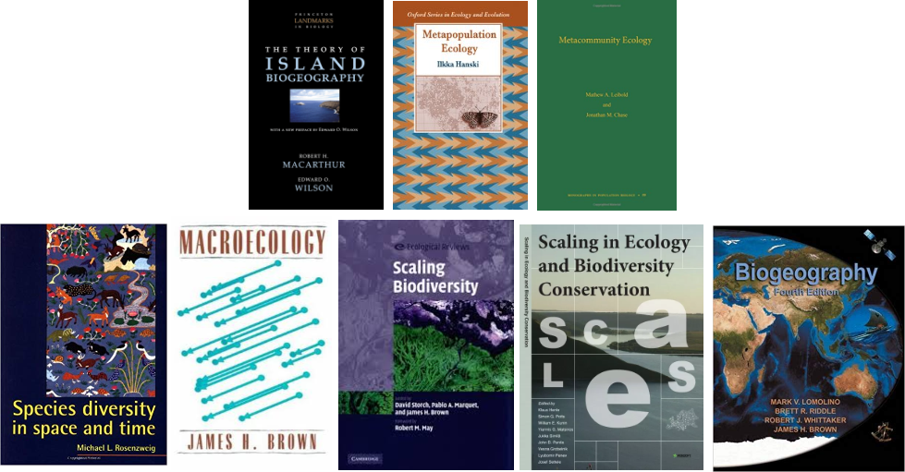
Because of SAR, practically everything about biodiversity is grain-dependent
Notes:
In this panel we can probably all agree that biodiversity is one of the most valuable natural resources.
But things like climate change or habitat loss are a threat to biodiversity, to the extent that we hear about biodiversity crisis, or sixth mass extinction
For example, about 1% of vertebrate species have gone extinct because of humans

Slide 18
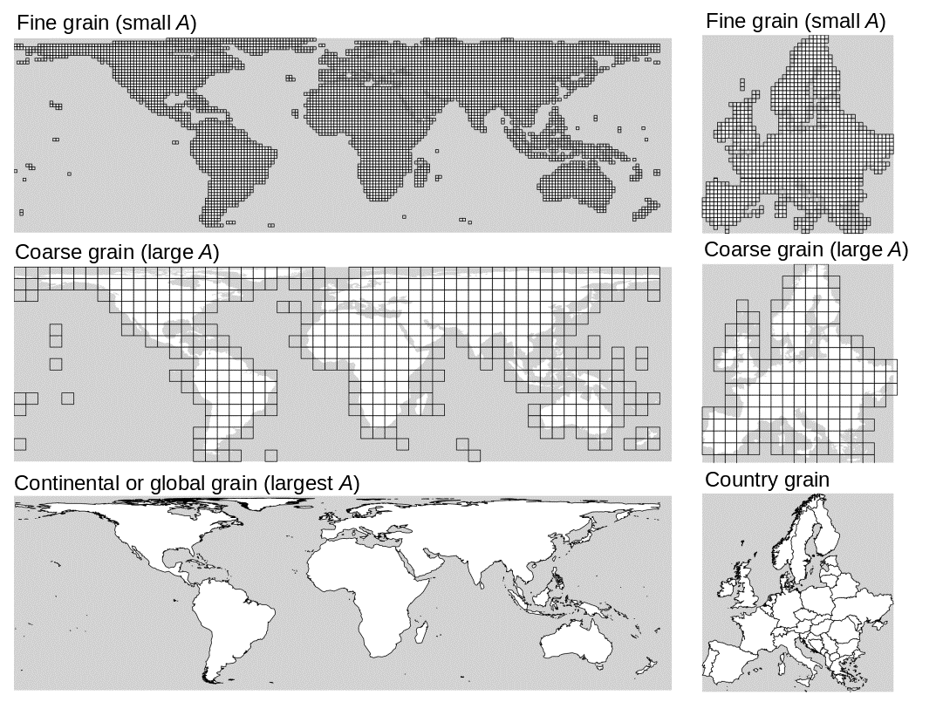
Because of SAR, practically everything about biodiversity is grain-dependent
Note you should know that:
Scale is the most general term with vague meaning, and has several more precise facets:
Grain is the resolution, i.e. average area of a spatial unit
Extent is the area of the entire region over which we overlay the grid
Support, or cover, is the total number of grid cells, it is the “fill” of the grid
Notes:
In this panel we can probably all agree that biodiversity is one of the most valuable natural resources.
But things like climate change or habitat loss are a threat to biodiversity, to the extent that we hear about biodiversity crisis, or sixth mass extinction
For example, about 1% of vertebrate species have gone extinct because of humans

Slide 19
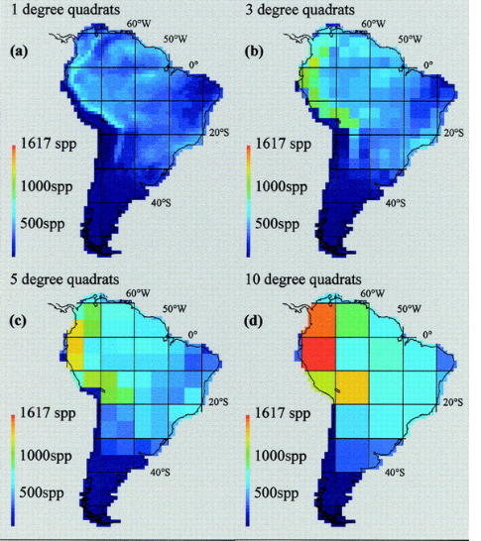
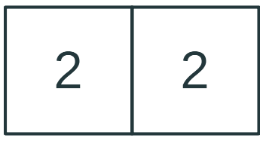
Spatial patterns of biodiversity are grain-dependent
Species richness of South-American birds
?
High beta diversity
Low beta diversity
Rahbek & Graves (2001) PNAS
Notes:
In this panel we can probably all agree that biodiversity is one of the most valuable natural resources.
But things like climate change or habitat loss are a threat to biodiversity, to the extent that we hear about biodiversity crisis, or sixth mass extinction
For example, about 1% of vertebrate species have gone extinct because of humans

Slide 20
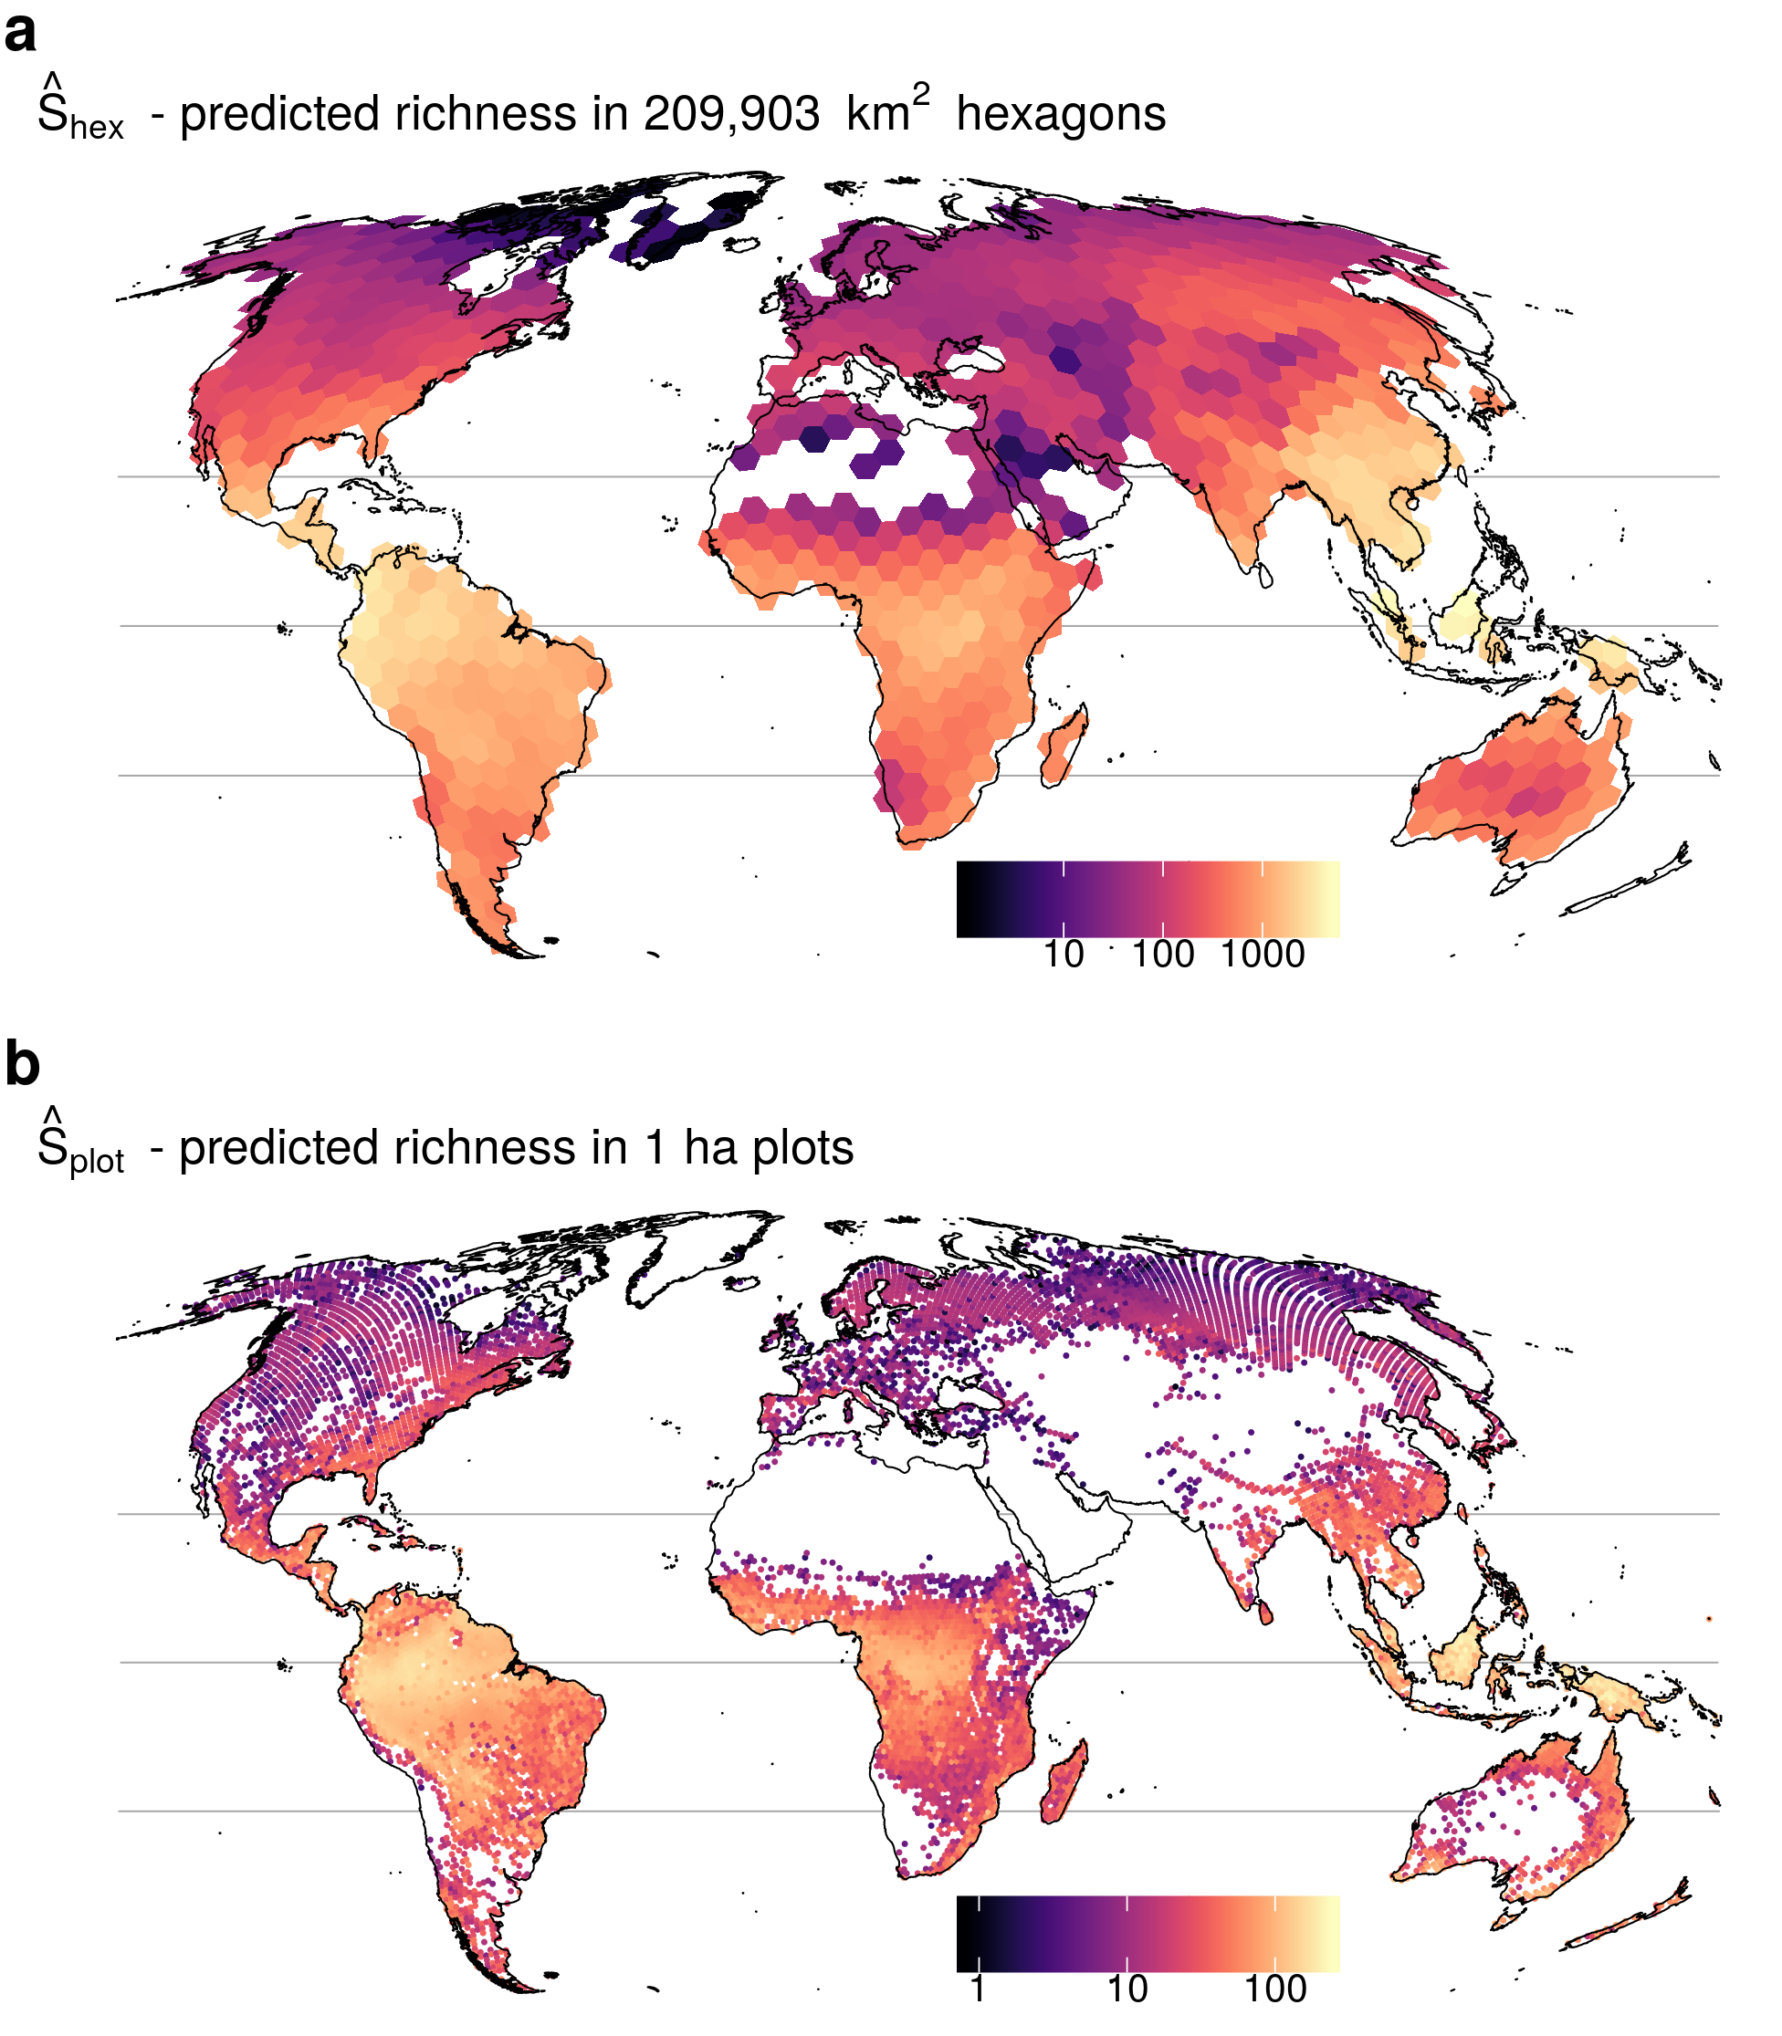
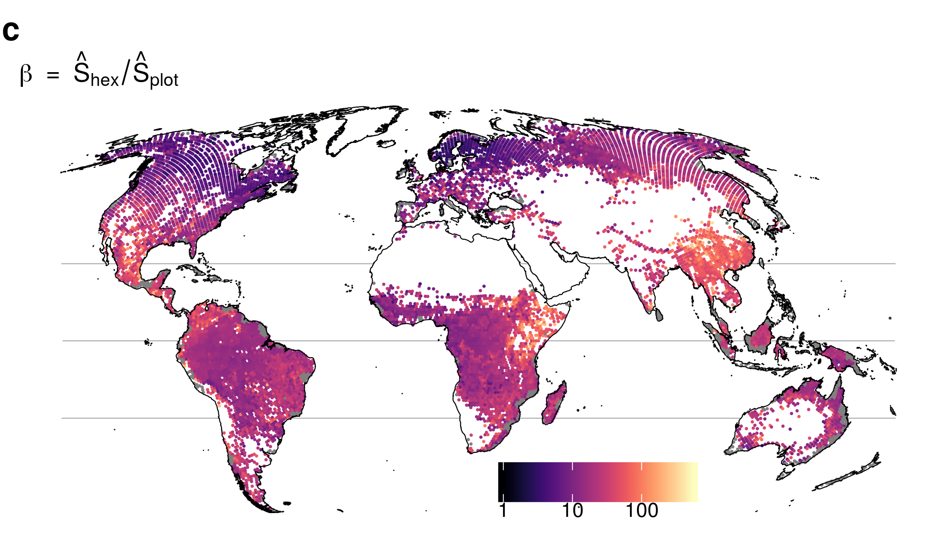
Spatial patterns of biodiversity are grain-dependent
Species richness of trees in forests
Beta diversity
Keil & Chase (2019) Nature Ecology and Evolution
Notes:
In this panel we can probably all agree that biodiversity is one of the most valuable natural resources.
But things like climate change or habitat loss are a threat to biodiversity, to the extent that we hear about biodiversity crisis, or sixth mass extinction
For example, about 1% of vertebrate species have gone extinct because of humans

Slide 21
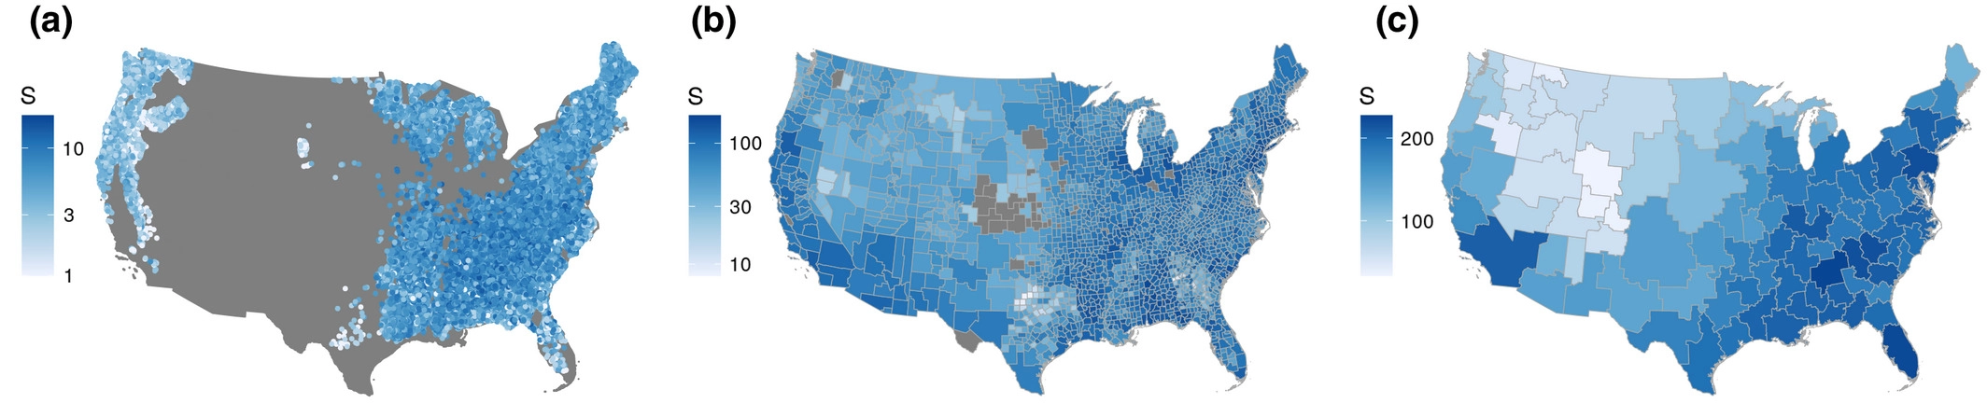
Environmental predictors of biodiversity are grain-dependent
Tree diversity in the US
Craven, … & Keil (2020) Global Ecology and Biogeography
Notes:
In this panel we can probably all agree that biodiversity is one of the most valuable natural resources.
But things like climate change or habitat loss are a threat to biodiversity, to the extent that we hear about biodiversity crisis, or sixth mass extinction
For example, about 1% of vertebrate species have gone extinct because of humans

Slide 22
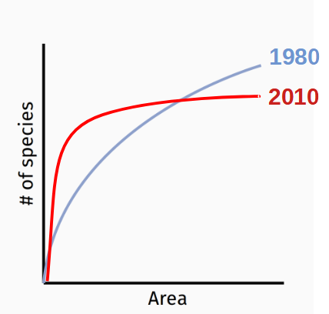
Biodiversity change is grain dependent
decrease
increase
Keil et al. (2011) Ecography
Powell et al. (2013) Science
Notes:
In this panel we can probably all agree that biodiversity is one of the most valuable natural resources.
But things like climate change or habitat loss are a threat to biodiversity, to the extent that we hear about biodiversity crisis, or sixth mass extinction
For example, about 1% of vertebrate species have gone extinct because of humans

Slide 23
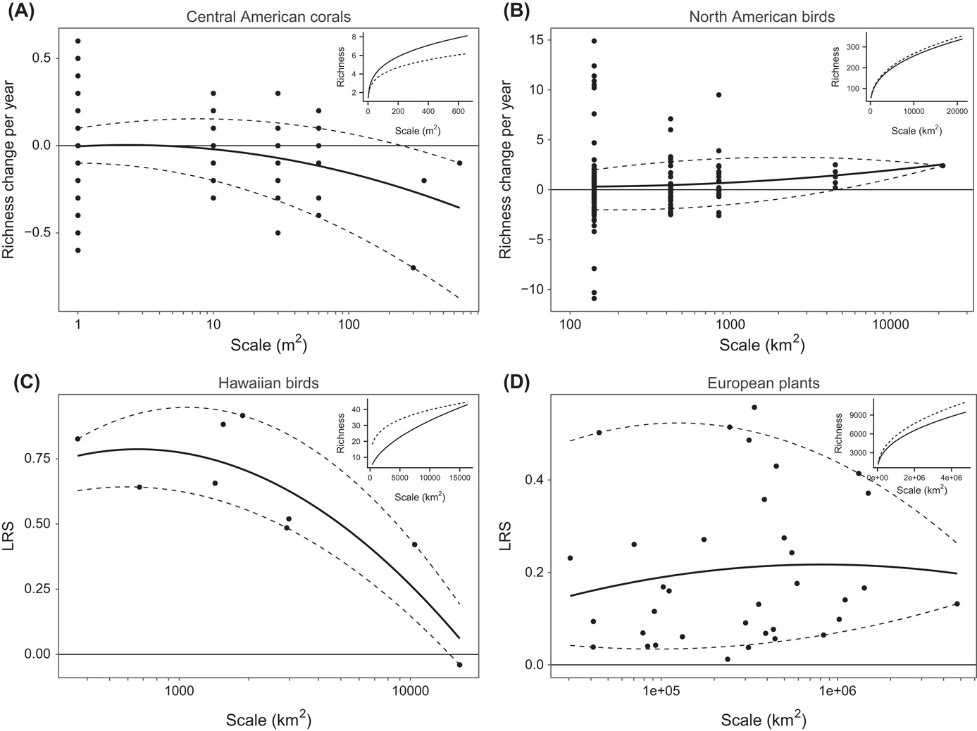
Biodiversity change is grain dependent
Chase et al. (2019) Oikos
Notes:
In this panel we can probably all agree that biodiversity is one of the most valuable natural resources.
But things like climate change or habitat loss are a threat to biodiversity, to the extent that we hear about biodiversity crisis, or sixth mass extinction
For example, about 1% of vertebrate species have gone extinct because of humans

Slide 24
The paradox of global biodiversity change
Dornelas et al. (2014) Science
Barnosky et al. (2011) Nature
Notes:
In this panel we can probably all agree that biodiversity is one of the most valuable natural resources.
But things like climate change or habitat loss are a threat to biodiversity, to the extent that we hear about biodiversity crisis, or sixth mass extinction
For example, about 1% of vertebrate species have gone extinct because of humans

Slide 25
You should know
Because of the SAR, most patterns of biodiversity are grain-dependent this includes
Geographic patterns of biodiversity
Environmental drivers of biodiversity
Temporal change of biodiversity
Notes:
In this panel we can probably all agree that biodiversity is one of the most valuable natural resources.
But things like climate change or habitat loss are a threat to biodiversity, to the extent that we hear about biodiversity crisis, or sixth mass extinction
For example, about 1% of vertebrate species have gone extinct because of humans

Slide 26
Related concepts
STAR, rarefaction curves, endemics-area relationships
Notes:
I am qualified to deliver all this

Slide 27
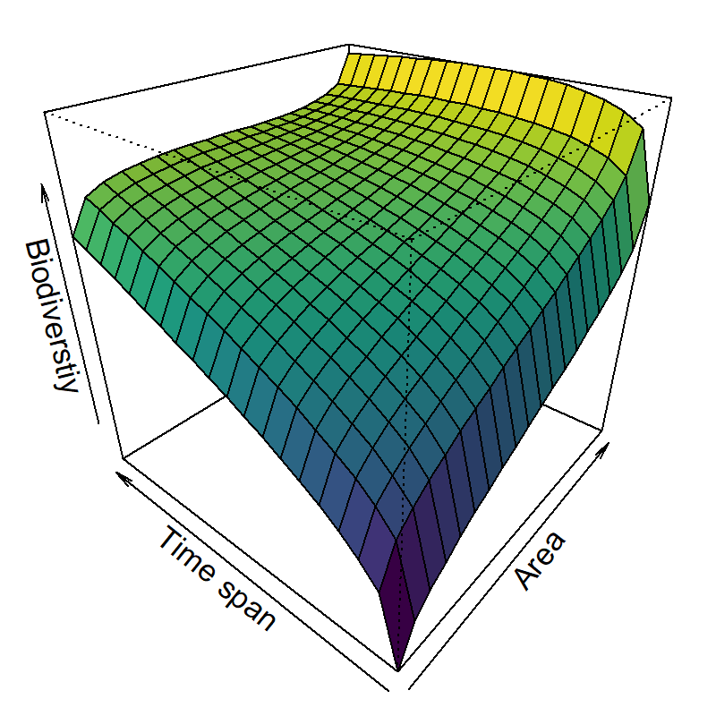
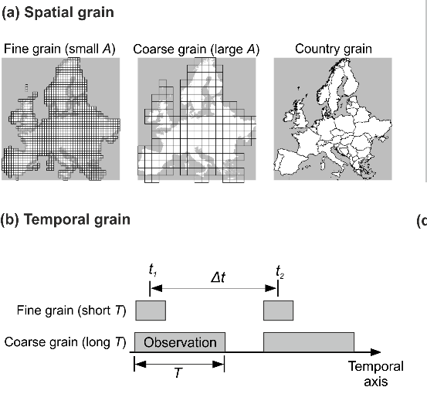
Species-time-area relationship (STAR)
Adler et al. (2004) Ecology
Notes:
In this panel we can probably all agree that biodiversity is one of the most valuable natural resources.
But things like climate change or habitat loss are a threat to biodiversity, to the extent that we hear about biodiversity crisis, or sixth mass extinction
For example, about 1% of vertebrate species have gone extinct because of humans

Slide 28
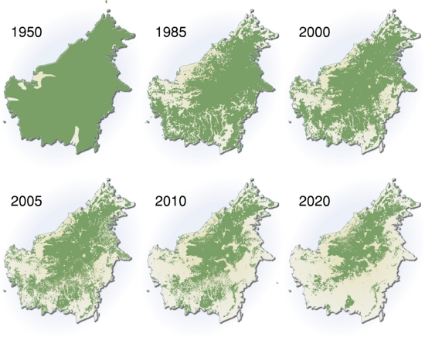
Species loss due to area loss: The Endemics-Area relationship (EAR)
Deforestation of Borneo (source: UNEP)
He & Hubbell (2011) Nature
Notes:
In this panel we can probably all agree that biodiversity is one of the most valuable natural resources.
But things like climate change or habitat loss are a threat to biodiversity, to the extent that we hear about biodiversity crisis, or sixth mass extinction
For example, about 1% of vertebrate species have gone extinct because of humans

Slide 29
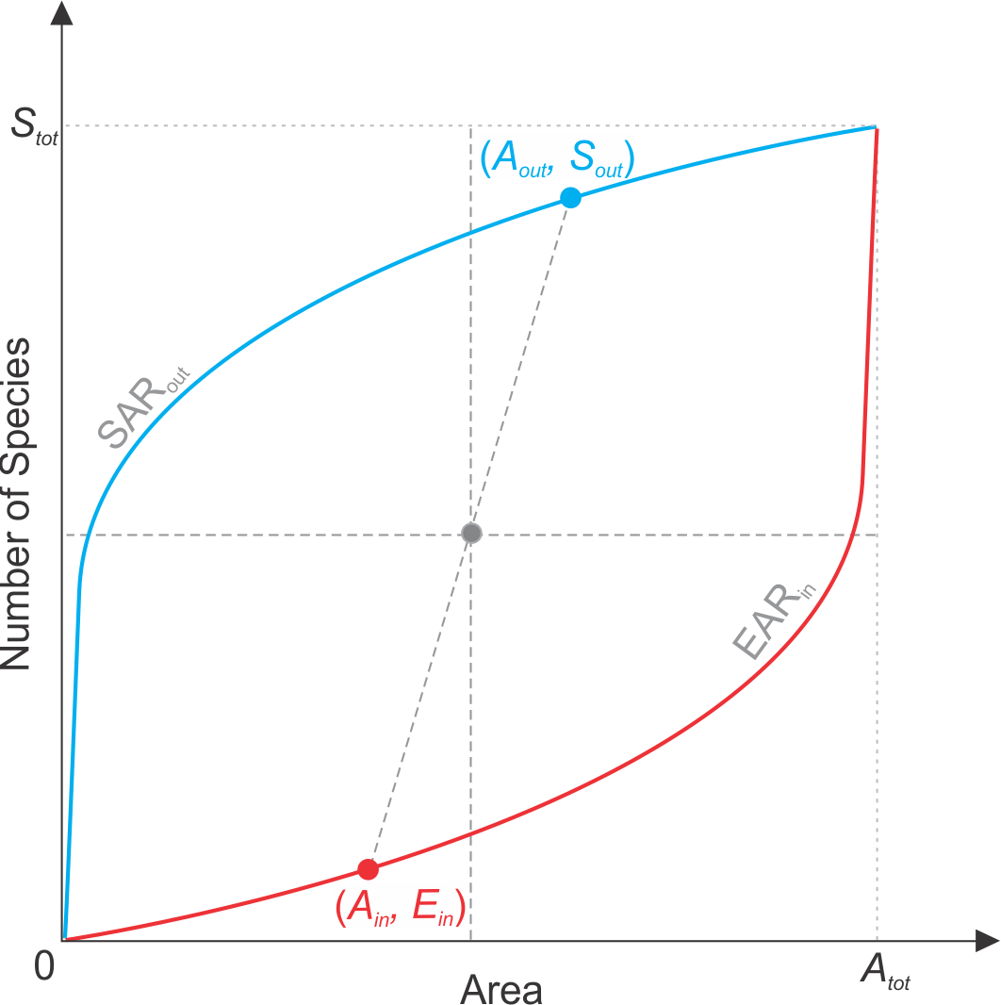
Species loss due to area loss: The Endemics-Area relationship (EAR)
Encountered species follow
standard species-area relationship (SAR)
Direction of
loss
Species range
Lost species follow
endemics-area relationship (EAR)
He & Hubbell (2011) Nature
Keil, Storch & Jetz (2015) Nature Communications
Notes:
In this panel we can probably all agree that biodiversity is one of the most valuable natural resources.
But things like climate change or habitat loss are a threat to biodiversity, to the extent that we hear about biodiversity crisis, or sixth mass extinction
For example, about 1% of vertebrate species have gone extinct because of humans

Slide 30
Species accumulation curves: Individual-based rarefaction
Community 2
Community 1
# of Individuals
Gotelli & Colwell (2001) Ecology Letters
R package vegan by Jari Oksanen
Notes:
In this panel we can probably all agree that biodiversity is one of the most valuable natural resources.
But things like climate change or habitat loss are a threat to biodiversity, to the extent that we hear about biodiversity crisis, or sixth mass extinction
For example, about 1% of vertebrate species have gone extinct because of humans

Slide 31
Species accumulation curves – Sample-based rarefaction
Sample
Meadow
Meadow
Forest
Forest
# of Samples
Gotelli & Colwell (2001) Ecology Letters
R package vegan by Jari Oksanen
Notes:
In this panel we can probably all agree that biodiversity is one of the most valuable natural resources.
But things like climate change or habitat loss are a threat to biodiversity, to the extent that we hear about biodiversity crisis, or sixth mass extinction
For example, about 1% of vertebrate species have gone extinct because of humans

Slide 32
You should know
Apart from spatial grain, there is also temporal grain, and consequently a species-time-area relationship
SAR is related to “endemics-area relationship” (EAR), which can be used to estimate species loss from the loss of habitat area
SAR is a type of species accumulation curve, which also includes individual-based and sample-based rarefaction. These can be used to compare diversity of communities with different numbers of individuals.
Notes:
In this panel we can probably all agree that biodiversity is one of the most valuable natural resources.
But things like climate change or habitat loss are a threat to biodiversity, to the extent that we hear about biodiversity crisis, or sixth mass extinction
For example, about 1% of vertebrate species have gone extinct because of humans

Slide 33
Thank you. Questions?

